Slide 1
Operational Interpretation of the Choi Rank Through Exclusion Tasks
Benjamin Stratton, Chung-Yun Hsieh, Paul Skrzypczyk

Slide 2
Results Overview
We have given the rank of the Choi-state an operational interpretation through an entanglement assisted exclusion task
We have given the rank of the Choi-state an operational interpretation through an entanglement assisted exclusion task
We have given the rank of the Choi-state an operational interpretation through an entanglement assisted exclusion task

Slide 3
Overview
State Discrimination and State Exclusion Tasks
Superdense Coding and State Discrimination
Superdense Coding and State Exclusion?
An operational interpretation of the Choi-rank

Slide 4
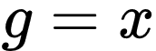

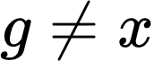

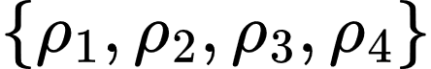
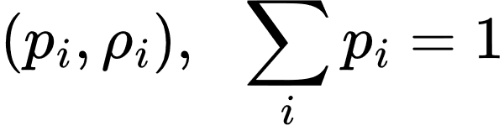




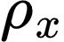
State Discrimination
If:
Referee
Bob

Slide 5
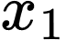
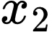
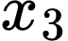
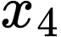
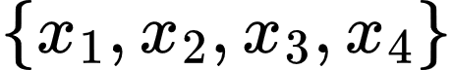
State Discrimination as Communication
Aim: Alice wants to send one of the following messages to Bob
Alice
Bob
using
Encoding/Decoding

Slide 6
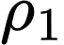
State Discrimination as Communication
Alice
How does our machine work?
Bob
If Alice wants to send the message
Alice’s Box makes a state and sends it to Bob’s box
Bob’s box measures and decodes the message
Encoding/Decoding

Slide 7
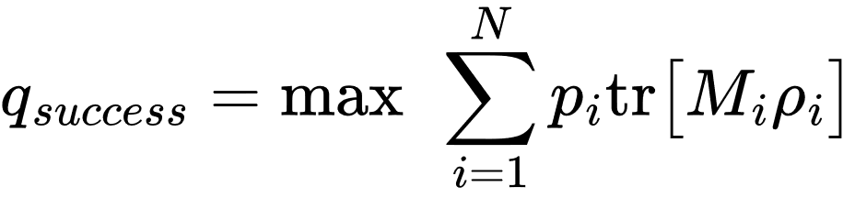
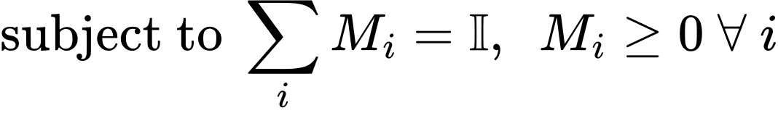
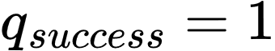
State Discrimination – Formally
Probability that Bob outputs
such that
if and only if are all orthogonal
Alternatively: When communicating one of a set of four messages via the quantum states ,
this can only be done with zero error if they are all orthogonal
Positive Operator Value Measure (POVM) – General model of measurement

Slide 8

Noise
Alice sends:
Bob Receives:
Alice
Bob
In general Alice cannot communicate a message to Bob, via encoding in quantum states, without there being some probability of error.
Completely Positive Trace Preserving (CPTP) Map

Slide 9
What can Bob conclude with certainty?
In general, Bob can never say with certainty what message Alice encoded.
Can Bob conclude something weaker about Alice’s encoded message with certainty?
Can Bob say with certainty what message Alice did not encode?

Slide 10
Exclusionary Information
Box 1
Box 2
Box 3
Box 4
The ball is not in box 1, box 3 or box 4
The ball is in box 2
=

Slide 11

Exclusionary Information
?
?
Box 1
Box 2
Box 3
Box 4
The ball is in box 2
The ball is not in box 1, box 3
$$≥$$

Slide 12
Exclusionary Information
?
?
?
Box 1
Box 2
Box 3
Box 4
The ball is in box 2
The ball is not in box 3
$$≥$$

Slide 13
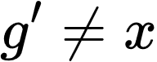
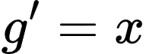
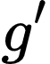
State Exclusion
If:
Referee
Bob

Slide 14
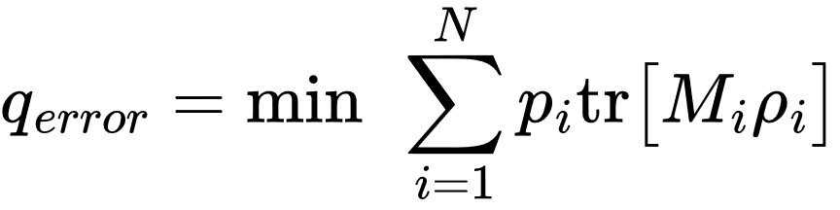
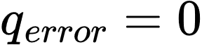
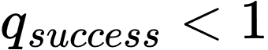
State Exclusion – Formally
Probability that Bob outputs
such that
For a given set of states , it is possible that
when
Positive Operator Value Measure (POVM) – General model of measurement

Slide 15
Conclusive State Exclusion
Get conclusive state exclusion when:
Meaning that with each measurement outcome one can output a state with certainty that was not sent.
K-State Exclusion
Consider a set of N states upon which exclusion is being perform.
Get k-state exclusion when k states are excluded with each measurement outcome, k ≤ N-1.
Here, we consider conclusive k-state exclusion.

Slide 16
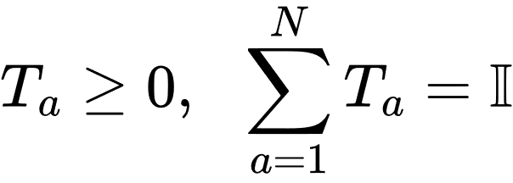
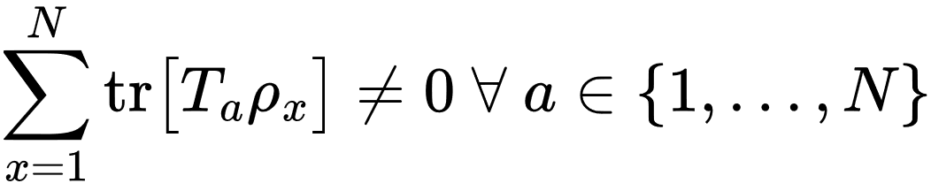
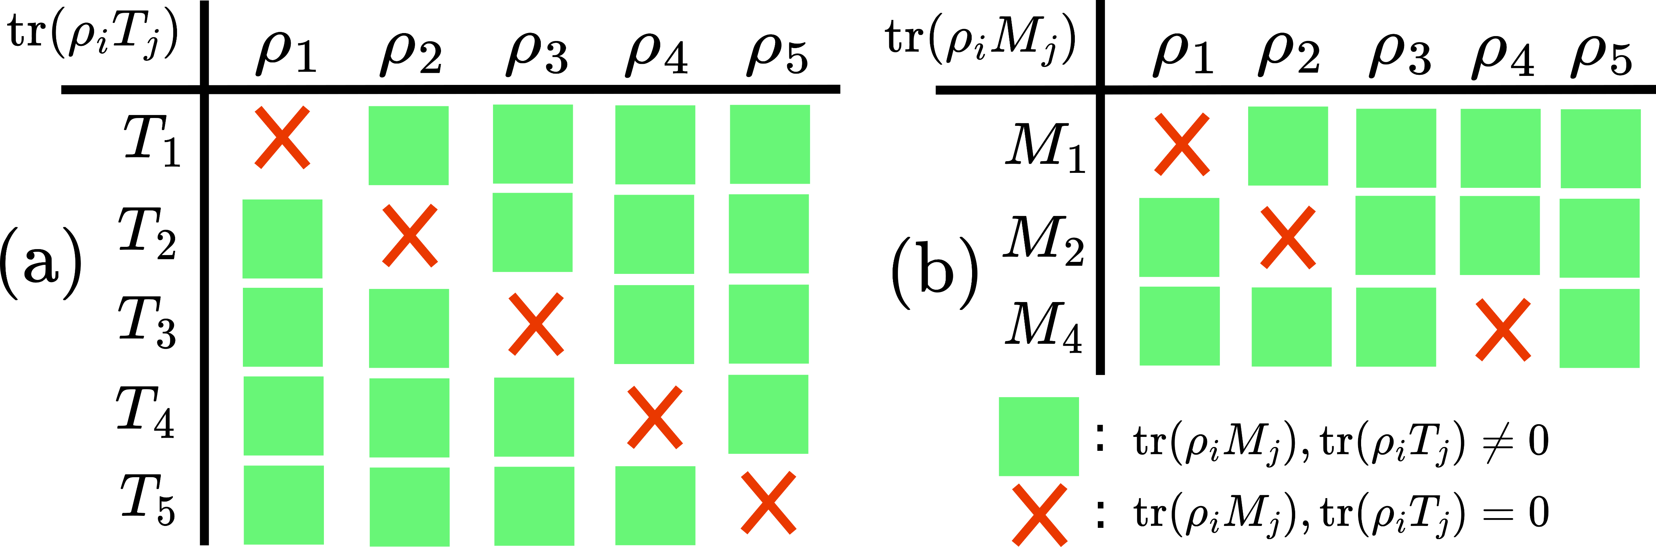
Conclusive Weak and Strong Exclusion
Conclusive Weak Exclusion Condition
Conclusive Strong Exclusion Condition
Strong
Weak

Slide 17
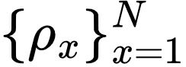
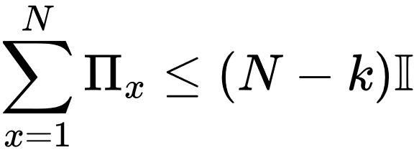
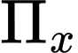
Necessary Condition for k-state Exclusion
Lemma 1. A referee has a set of N, d-dimensional quantum states
A necessary condition for the existence of a POVM such that an agent can perform conclusive strong or weak k-state exclusion is
Where is the projector on the state for all x.
Have examples of families of states for which this is tight

Slide 18
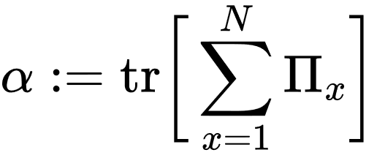
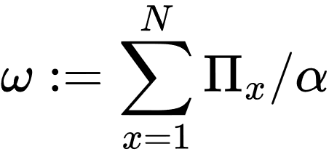
Necessary Condition for k-state Exclusion
Corollary 1. When performing conclusive weak or strong k-state exclusion on , an upper bound on the number, k, states that can be excluded is given by
Where:

Slide 19
Previously: State Discrimination as Communication
Aim: Alice wants to send one of the following messages to Bob
Bob
Alice
using
In general, Bob can never be certain which message Alice sent
Alice sends:
Bob Receives:

Slide 20
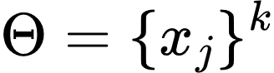
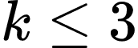
State Exclusion as Communication?
Bob’s box now performs state exclusion.
Bob
Alice
Bob’s box outputs a set of message
that Alice did not send with certainty.
Where
Alice sends:
Bob Receives:

Slide 21
We are using the notion of conclusive k-state exclusion to quantify what Bob can say with certainty about Alice’s encoded message in a communication task.
The communication task we specifically consider was super-dense coding.

Slide 22
Super-dense Coding

Slide 23
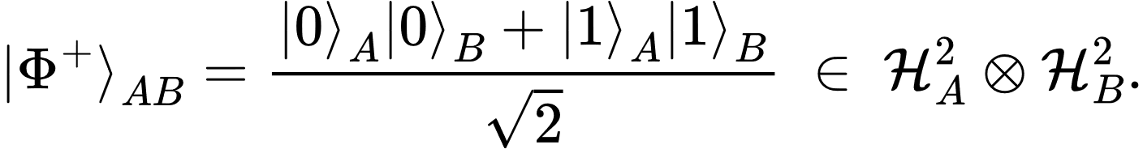
Super-dense Coding
Alice (A) and Bob (B), are two spatially separated parties who share a d=2 dimension maximally entangled bipartite state,
Aim: Alice wants to send Bob two bits using one qubit

Slide 24

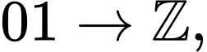


Super-dense Coding
1. Alice encodes the two bits she wants to send by applying the following unitaries to the state in her system:
Two-bit strings
Qubits Pauli Operators

Slide 25
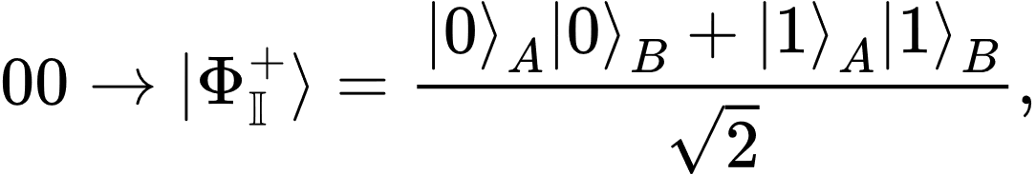
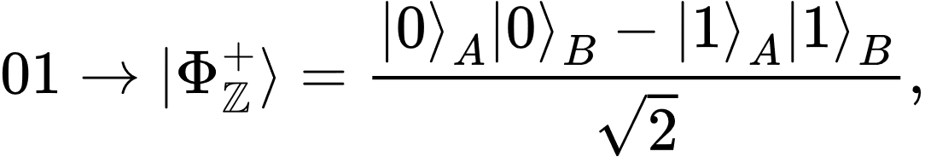
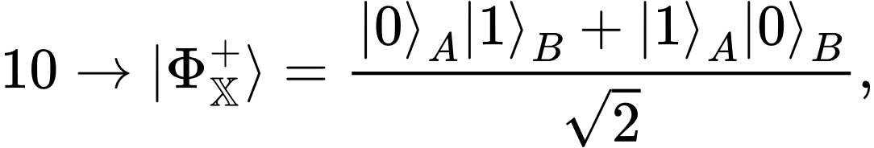
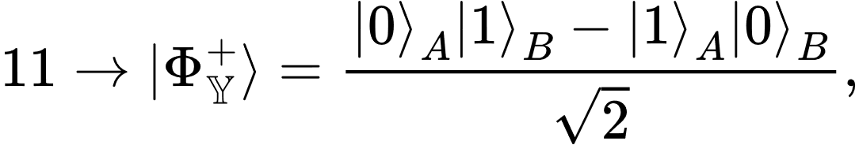
Super-dense Coding
Alice and Bob now share one of the Bell states:
Alice’s encoded message
State shared between Alice and Bob

Slide 26
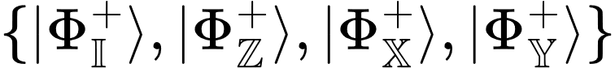
Super-dense Coding
2. Alice sends her half of the state to Bob.
Bob now has all of one of the following states:
If Bob can identify the state, he can decode the message

Slide 27
Super-dense Coding
3. Bob performs state discrimination on:
This set is orthogonal
Bob can decode Alice’s message with certainty

Slide 28
Super-dense Coding
3. Bob performs state discrimination on:
Bob measures:
where

Slide 29
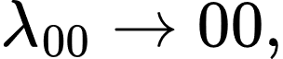
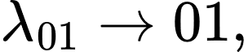
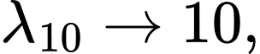
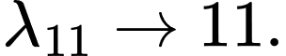
Super-dense Coding
3. Bob performs state discrimination on:
Bob outputs:
Bob’s measurement outcome
Decoded message

Slide 30
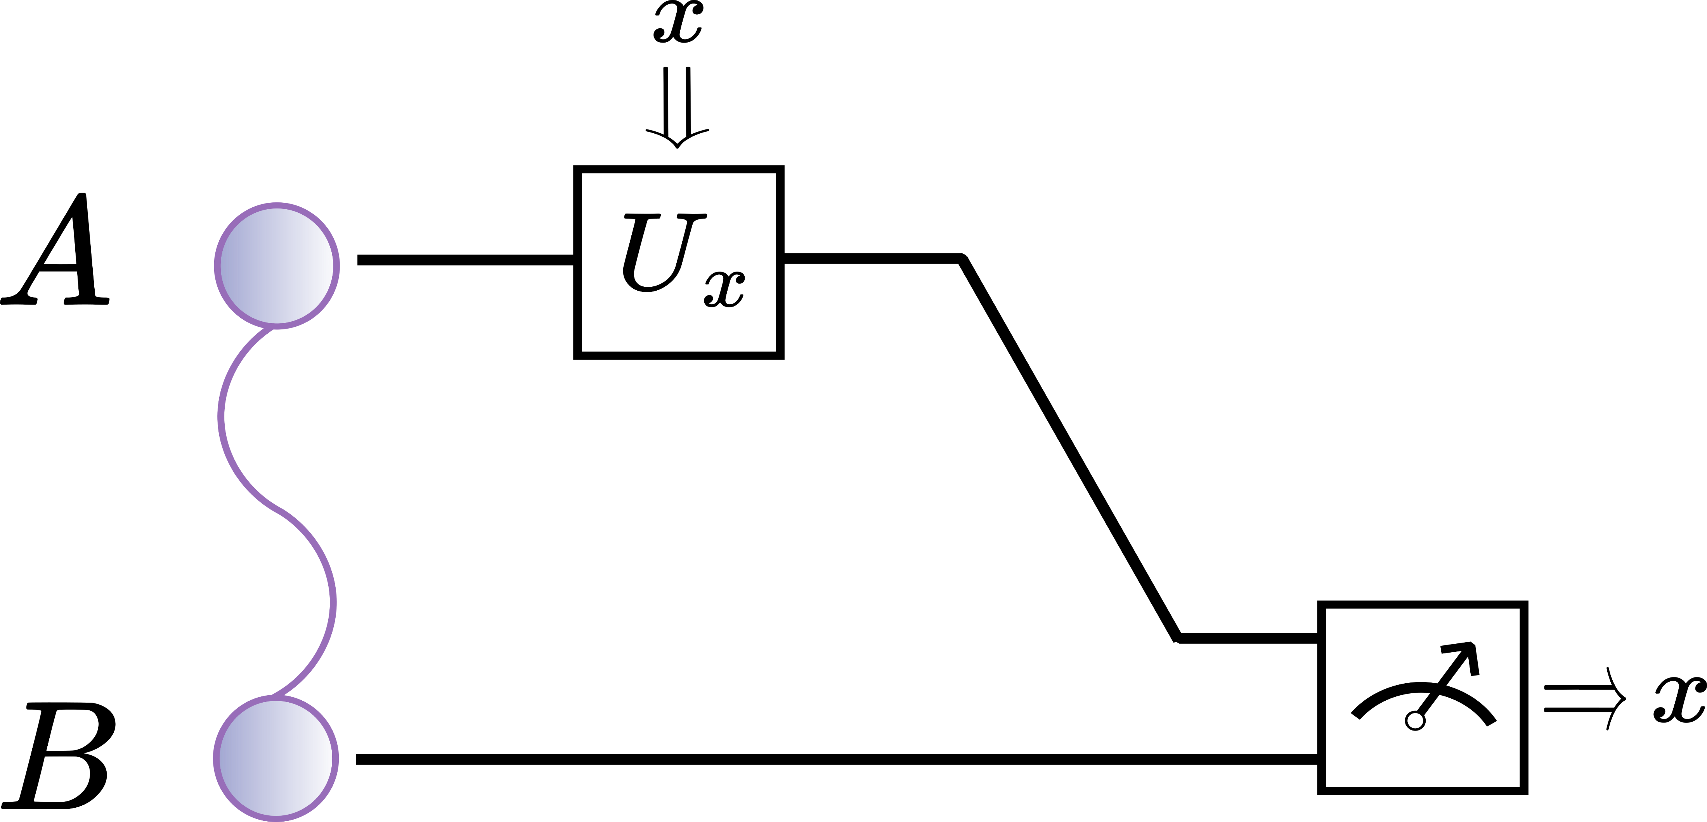
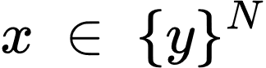
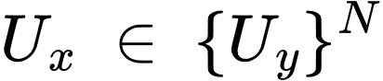
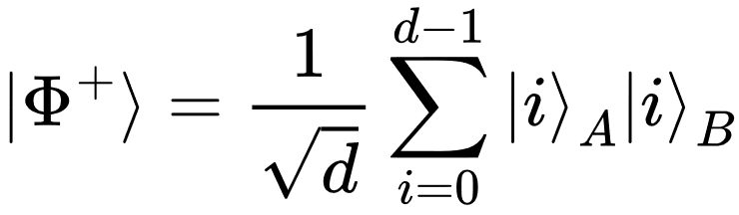
Super-dense Coding
Alice wants to send message to Bob
Alice locally applies the unitary
Alice send her half to Bob
Bob performs a joint measurements and outputs the message
Bipartite maximally entangled state

Slide 31
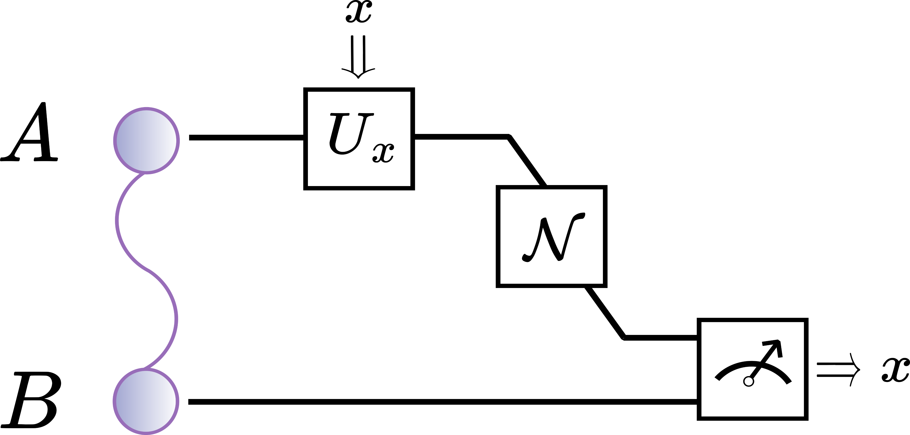

Super-dense Coding with Noise
Completely Positive Trace Preserving (CPTP) Map
In general, Bob loses the ability to be certain about which message Alice encoded.

Slide 32
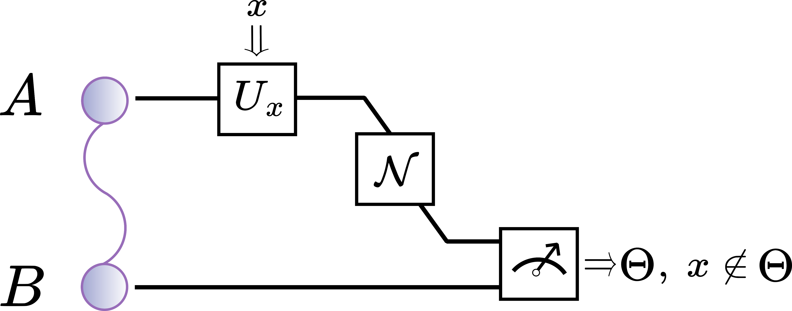
Super-dense Coding with Exclusion
Keep bulk of protocol the same
Swap state discrimination for state exclusion at the conclusion of the protocol
Aim: What can Bob say for certain about Alice’s encoded message

Slide 33
Task Overview
Alice and Bob share d dimensional maximally entangled state, and Alice wants to use it to send Bob one of N messages (bit-strings).
Alice encodes the message by acting a unitary on her local system.
Alice sends her half of the state to Bob through the channel
Bob performs a joint measurement and outputs a set of k messages he is certain Alice did not send.
We measure Bob’s success in the task via his maximum possible k
If k = N – 1, Bob is certain of the message Alice encoded.

Slide 34
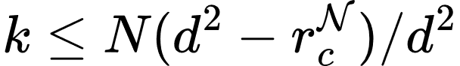
Result 1
The maximum number of messages it is possible for Bob to exclude is upper bounded by:
Choi rank of the channel
Total number of messages
Dimension of shared maximally entangled

Slide 35


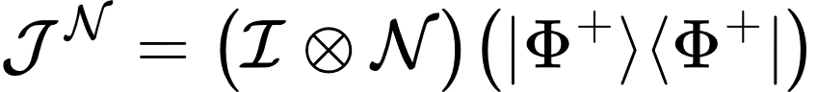
Choi-State
isomorphic

Slide 36
Choi-State
Allows questions involving dynamics to be simplified and then solved analytically and numerically.
Offers an alternative method to characterise dynamics
Properties of the Choi-state can provide insight into the dynamics.
Typically, these insights have been about the mathematical structure of the channel’s description.

Slide 37
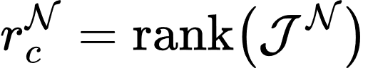





Choi-rank
Characterises Unitary Channels
Lower-bounds Number of Kraus Operators
Lower-bounds Dimension of the Environment

Slide 38
Operational Interpretation of the Choi-rank
The Choi-rank provides a fundamental upper bound on the number of states that can be excluded in an entanglement assisted exclusion task:
The Choi-rank provides a fundamental upper bound on the number of states that can be excluded in an entanglement assisted exclusion task:

Slide 39
The Choi-rank provides a fundamental upper bounds on the number of states that can be excluded in an entanglement assisted exclusion task:
This bound applies to all quantum channels, it cannot be improved upon in special cases.
This bound is tight.

Slide 40




This bound is tight.
Consider the dephasing channel:
Our bound implies:
This bound can be saturated for all d if one performs the typically super-dense coding protocol:
Encode using Heisenberg-Weyl operators.
Decode by measuring in Bell Basis.

Slide 41
The Choi-rank provides a fundamental upper bounds on the number of states that can be excluded in an entanglement assisted exclusion task:
This bound applies to all quantum channels, it cannot be improved upon in special cases.
This bound is tight.
Claim: A bound is fundamental if it cannot be improved upon and is tight

Slide 42
Operational Interpretation of the Choi-rank?
The Choi-rank has an operational interpretation as the limit to which an agent can succeed in this entanglement assisted exclusion task.
Have an operational task:
(Cannot be improved upon but tight)
+
a fundamental bound that limits an agent’s ability to succeed in the task

Slide 43
Future Work?
Does the bound still hold if one encodes using arbitrary quantum channels rather than unitary channels?
Holds for encoding via arbitrary unital channels
Does the bound still hold if use an arbitrary state rather than a maximally entangled state?

Slide 44
Summary
Introduced the idea of using exclusion to restore certainty in communication tasks.
Applied this to the well-known communication task of superdense coding, introducing the notion of entanglement assisted exclusion tasks.
Used this to provide an operational interpretation of the Choi-rank.

Slide 45
This work:
Operational Interpretation of the Choi Rank Through k-State Exclusion
Benjamin Stratton, Chung-Yun Hsieh, Paul Skrzypczyk
arXiv:2406.08360
More on Exclusion:
Conclusive Exclusion of Quantum States
Somshubhro Bandyopadhyay, Rahul Jain, Jonathan Oppenheim, Christopher Perry
arXiv:1306.4683
Antidistinguishability of Pure Quantum States
Teiko Heinosaari, Oskari Kerppo
arXiv:1804.10457
All quantum resources provide an advantage in exclusion tasks
Roope Uola, Tom Bullock, Tristan Kraft, Juha-Pekka Pellonpää, Nicolas Brunner
arXiv:1909.10484

Slide 46


K-State Exclusion

Slide 47


Rank

Slide 48

Sub-channel Exclusion

Slide 49
Operational Interpretation of the Choi Rank Through Exclusion Tasks and communication
Benjamin Stratton, Chung-Yun Hsieh, Paul Skrzypczyk

